Slide 1


Cybersecurity Web Application Guide

Slide 2

Background
This presentation will serve to showcase how the application works and demonstrate all main functionalities.
Objectives #01: Account Creation and Signup
Objectives #04: Admin Screens
Walk through creating an account, consent checkbox behavior, validation, and successful sign-in.
Show creating a CyberFair event, managing microcourses (on/off), scheduling sessions, and preventing double-bookings.
Objectives #02: Participant Screens
Objectives #03: Helper Screens
Show choosing university/event, viewing available microcourses, enrollment flow, and waitlist messages.
Show viewing assigned sessions, checking capacity, and seeing certification progress indicators.

Slide 3
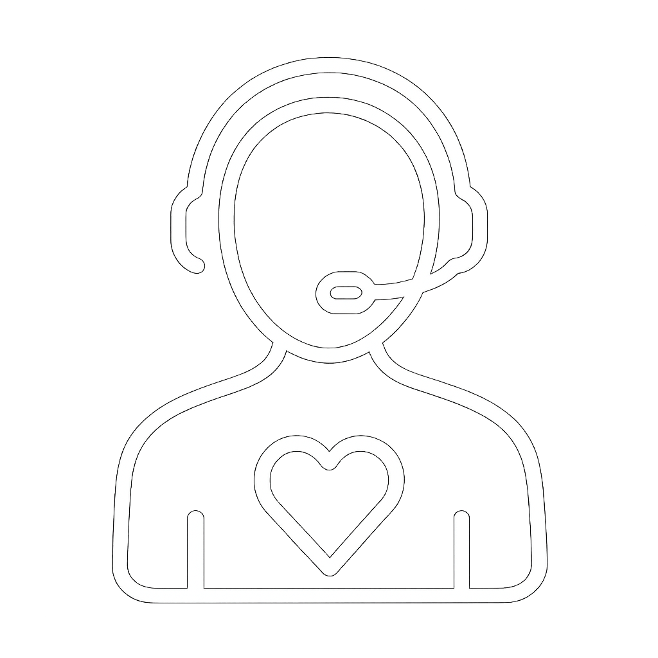
Table Of Contents
Table of Contents
Click on the image icon to go to the related section.
01
02
03
04
Account Creation & Sign Up
Participant Screens
Helper Screens
Admin Screens

Slide 4

Account Creation & Sign Up

Slide 5
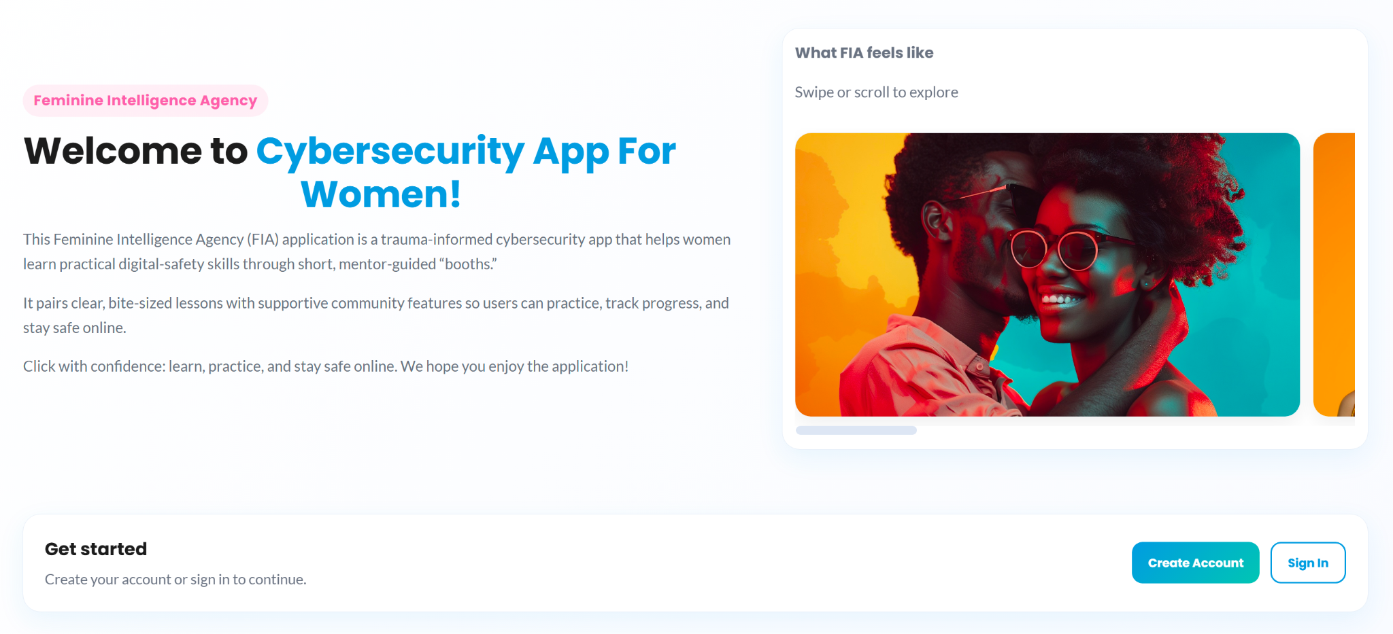
Table of Contents
1. Create Account
Navigate to the “Create Account” button at the bottom of the screen and click it to begin creating your account! If you are a University Admin or a Super Admin, you can ignore this as your credentials will already be made available to you. If you are a helper, the University Admin will provide you with credentials.

Slide 6
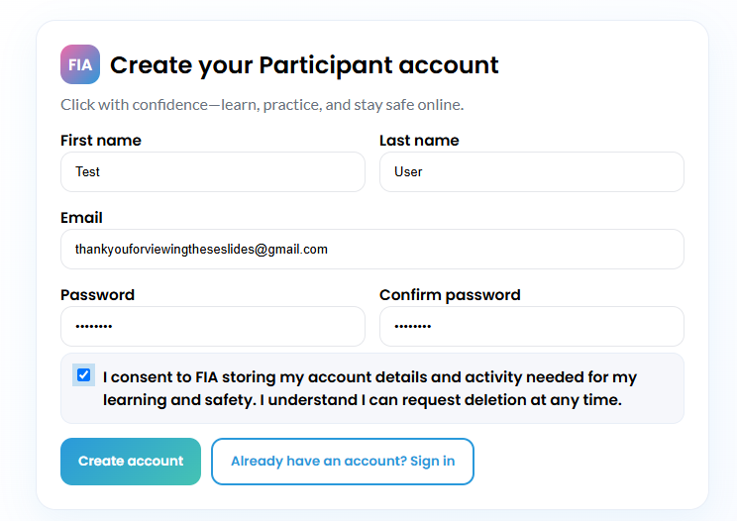
Table of Contents
2. Fill In Details
Fill in first name, last name, email, and a strong password. Afterwards, consent to FIA’s policy for storing account details if you agree. Then, finalize process by clicking “Create Account.” You will then be redirected to sign in! If you are on this screen by accident and already have an account made, click “Already have an account? Sign In.”

Slide 7
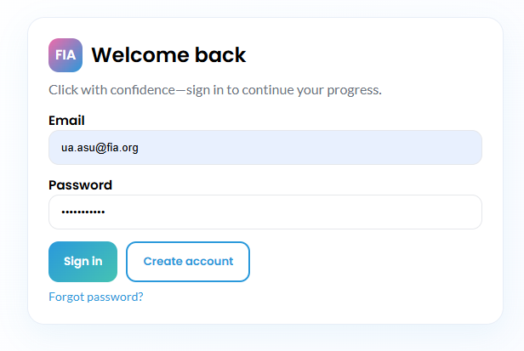
Table of Contents
3. Sign In
Enter in your account’s email and its corresponding password then press “Sign In.” You now have a usable participant account within the system! If you don’t have an account and are on this screen, click “Create Account.” We will implement functionality for password recovery in future sprints with “Forgot Password?”
Current Credentials for All User Types for Testing System:
Participant: u@gmail.com; 1
Helper: h@gmail.com; 1
University Administrator: ua.asu@fia.org; ASU-UA-Temp1!
Super Administrator: lauren@fia.org; FIA-SuperAdmin-Temp1!

Slide 8

Table of Contents
4. Account Made
Congratulations! You now have an account within the system and can use our freshly designed cybersecurity peer-to-peer learning functionalities!

Slide 9
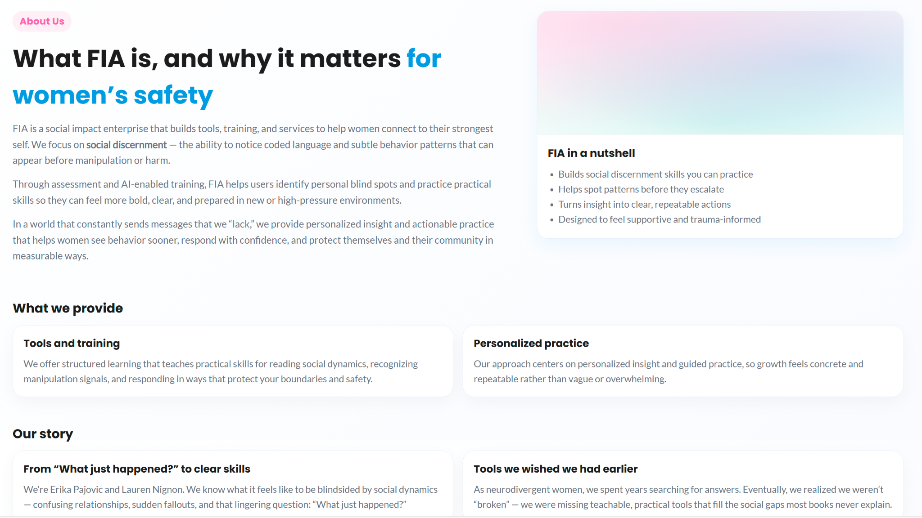
Table of Contents
5. About Us
From our home page, you can now learn more about Feminine Intelligence Agency’s Cybersecurity App for Women.

Slide 10
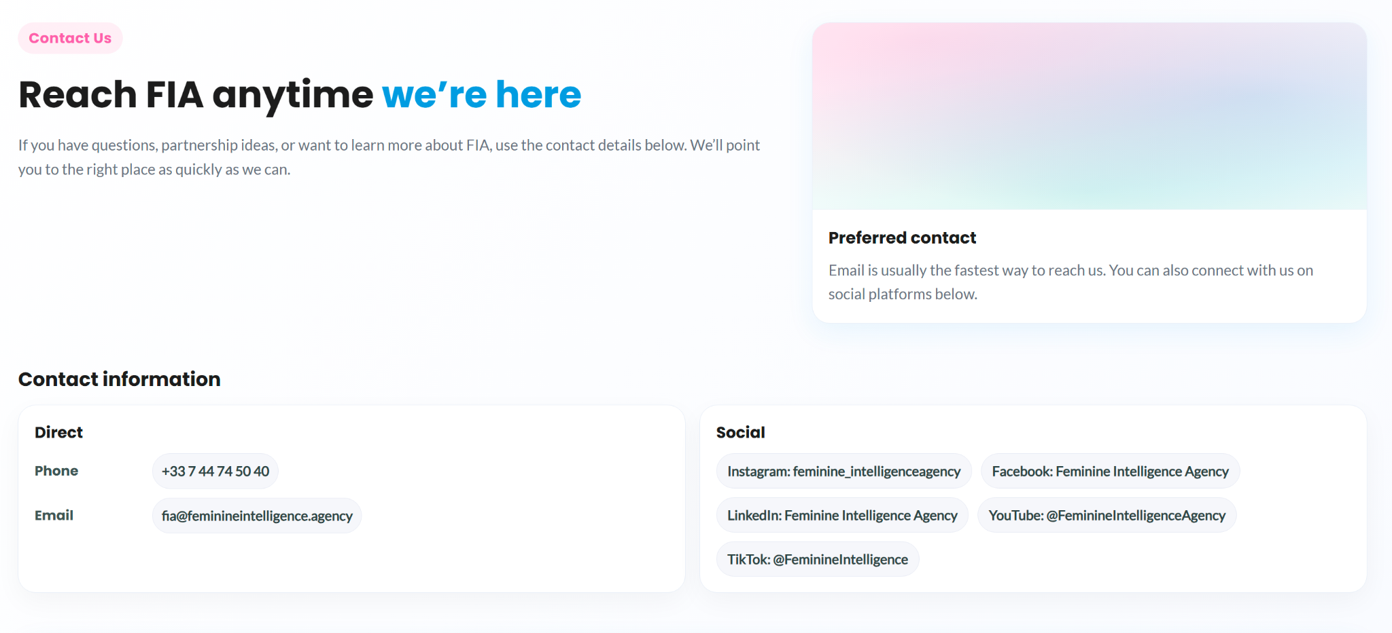
Table of Contents
6. Contact Us
You can also find contact information to address questions, partnership ideas, or to learn more about FIA through the Contact Us button on the home page.

Slide 11
Participant Screens

Slide 12
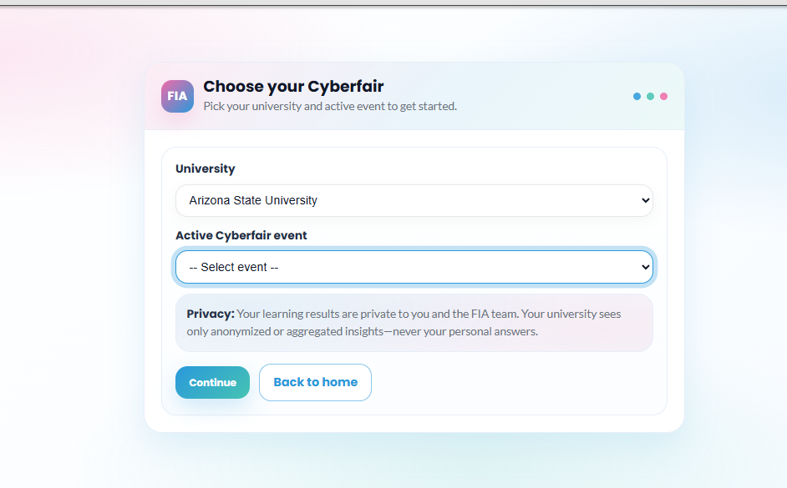
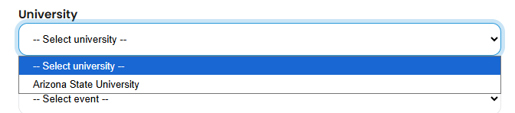
Table of Contents
1. University
This is the current home page for a participant after you sign in. To start using the application, select your appropriate university first from the drop down.

Slide 13
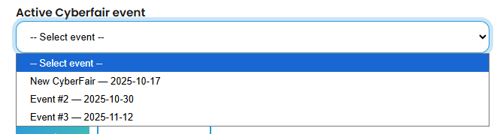
Table of Contents
2. Event
Once you have chosen a university, you can now look for upcoming (and active) cyberfair events. These are where peer helpers take their knowledge and deliver personal cybersecurity information/tips across a wide range of our microcourses. Select the cyberfair event you are interested in from the drop down box to scope in on it.

Slide 14
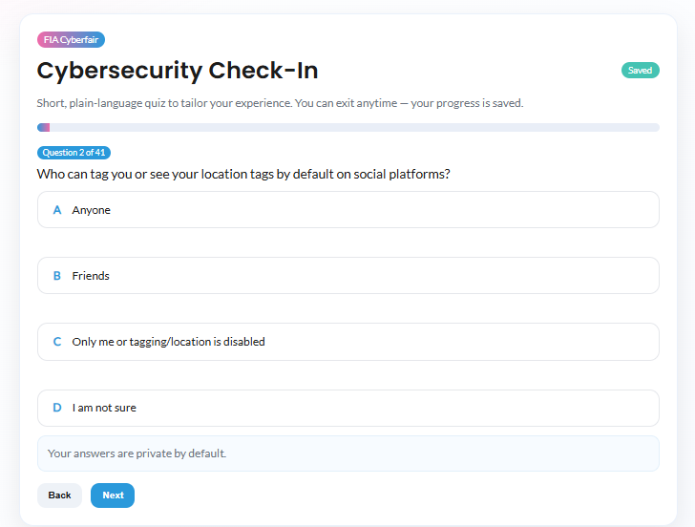
Table of Contents
3. Quiz
Upon signing in for the first time and choosing your event, you will need to complete the pre-event quiz which will be used to tailor sessions to you later on. You choose one answer per question and click next (you can also go back through questions). You can see your progress in the top bar and your progress is saved each question so you can leave whenever with no penalty.
Link to scoring guide: Click Here

Slide 15
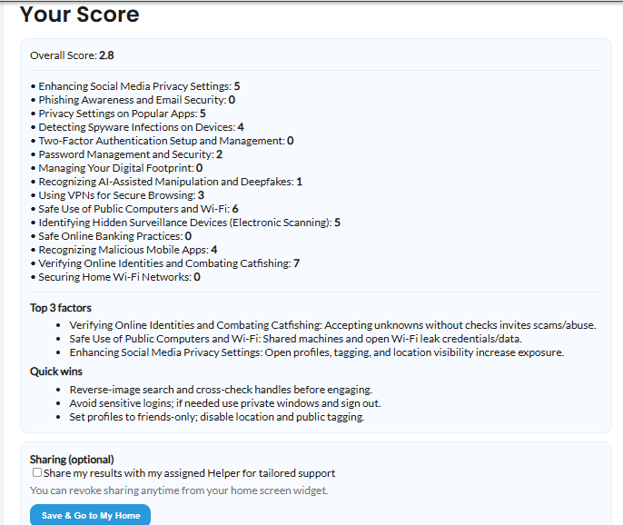
Table of Contents
4. Quiz Results
At the end, you will see your results with your cyber score, factors that impacted your score, and some quick wins to improve your security! You can now move onto joining sessions and using the application normally.

Slide 16
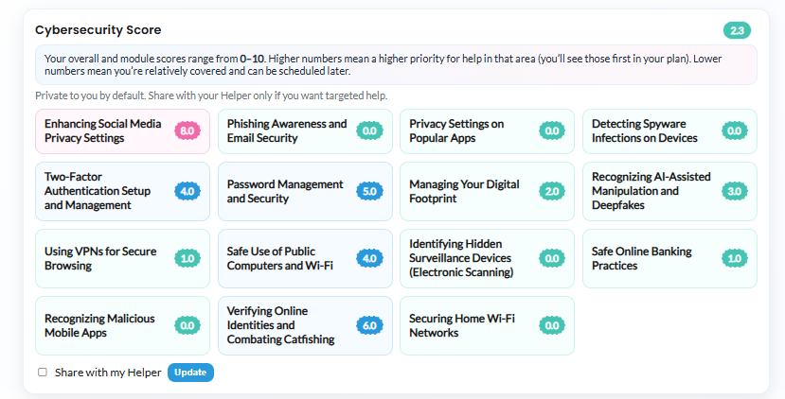
Table of Contents
5. Score
Once you have scoped into a university and taken the pre-event assessment, the first component you will see is your cybersecurity score. It is organized per module and also gives a total score. It’s a “risk/need” score per topic: 0 = very strong/low-risk, 1–3 = minor gaps, 4–6 = moderate risk (needs attention), 7–8 = high risk (priority to fix soon), 9–10 = critical risk (fix first). We will implement helper sharing in next sprint!

Slide 17
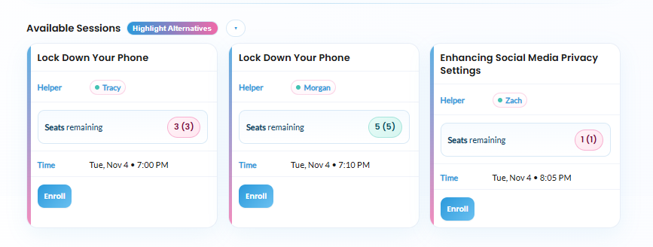
Table of Contents
6. View Sessions
On the screen near the bottom, you can view all available sessions including their helper name, seats remaining, and a time. You can enroll in any session you want if it has an Enroll button at the bottom.

Slide 18
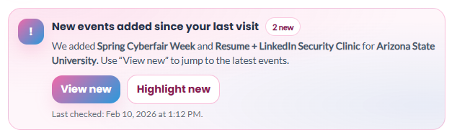
Table of Contents
7. New Sessions
Users can see a summary of newly added sessions since their last time on the website. They have the option to view only new sessions, or have the new sessions highlighted.

Slide 19
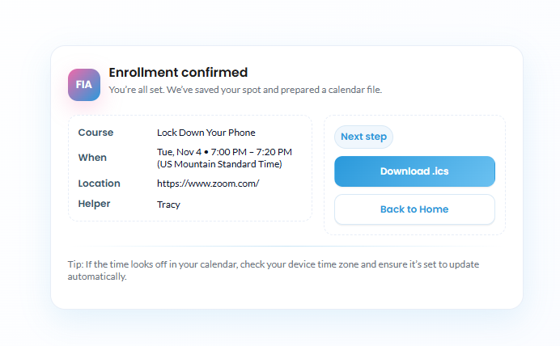
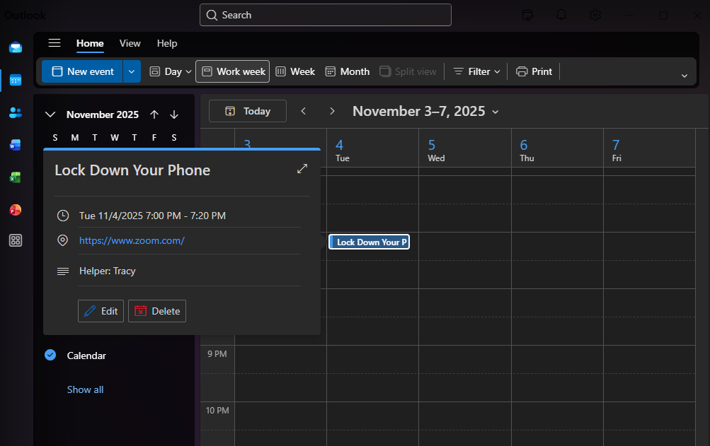
Table of Contents
8. Enroll Success
Once you enroll in a session, you will see the follow success screen. It shows you all session details, and allows you to download a .ics file which can be used to update your calendar of choice (example shown on right is through Outlook). From here, you can return to the event page with Back to Home where it will add the session to a new section called My Sessions.

Slide 20
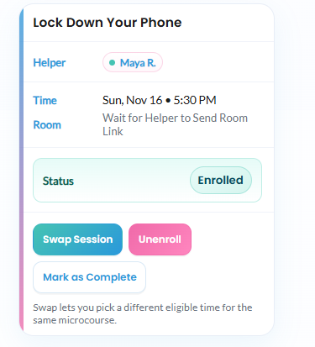
Table of Contents
9. My Sessions
Here, you can see the session in My Sessions and you can join the session with the Join Room hyperlink when the time comes. It also shows your current status and allows you to unenroll if you no longer want to join the session. Users can also swap sessions if they prefer a different one. NOTE: Mark as Complete is temporary and is used for testing purposes for right now.

Slide 21
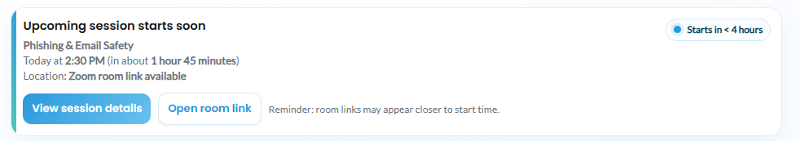
Table of Contents
10. Session Notifications
Users will receive a notification when one of their sessions they are enrolled in is in <4 hours. From the notification they can view session details or open the link to the meeting room.

Slide 22
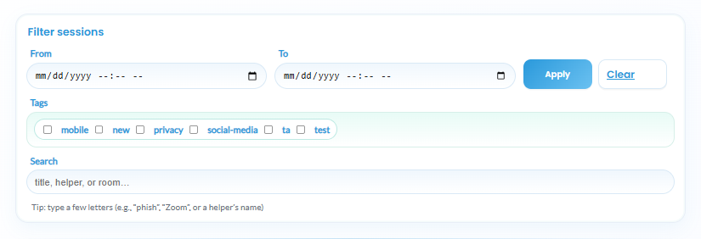
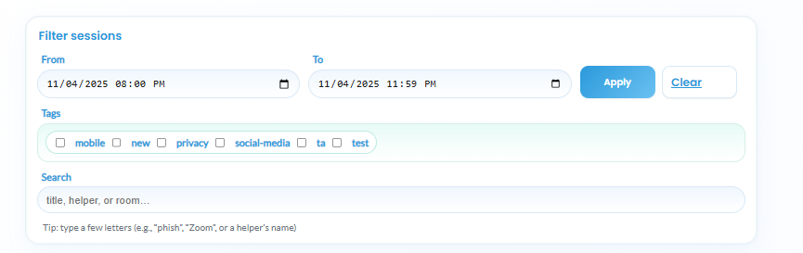
Table of Contents
11. Filters
Above the session cards, you can find the filters section. Here, you can filter using time ranges, tags, and a search feature (can be used to type in course name, helper, key words like phishing the user wants to see, etc.,). Upon clicking Apply, it will update the Available Sessions section. You can also clear the filter using Clear.
Example filter for sessions from 8:00 pm to 11:59 pm on November 4th. Result shown on next slide

Slide 23
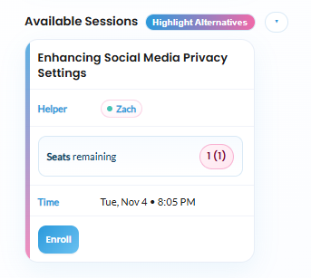
Table of Contents
12. Filter Result
Upon using the filter shown on the last slide, only this card is shown now in Available Sessions as this is the only session after 8:00 pm on November 4th currently in this example event. Once again, use the Clear button in the filter section if you want to get rid of this search and see all sessions as normal.

Slide 24
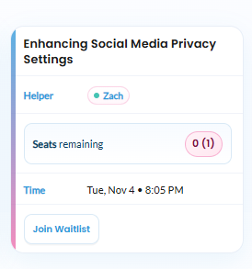
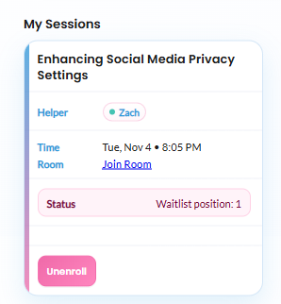
Table of Contents
13. Waitlist
There may be a case where there is a session you want to join but there are no remaining seats available. In this case there is no Enroll button, but there is a Join Waitlist button which will you place in a waitlist for the session which atomically updates when users unenroll or complete the session. Clicking Join Waitlist puts the card in My Sessions as well where you can see your position.

Slide 25
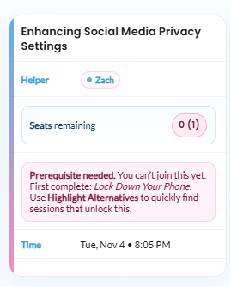
Table of Contents
14. Prereqs
In some cases, admins will set that certain courses require prerequisite courses to be completed first. If this is the case, the card will note the issue and the course(s) needed to be completed first to enroll or join waitlist. It also discusses using the Highlight Alternatives button which is shown on the next slide. Upon completing one session in the specific prereq course, it will unblock the blocked course!

Slide 26
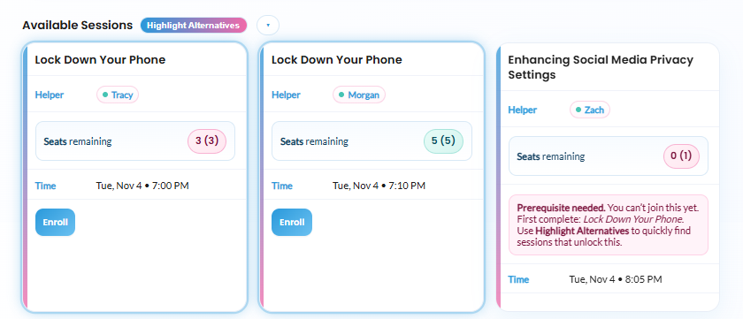
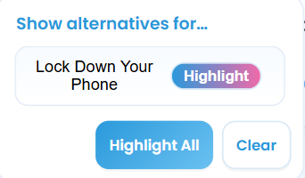
Table of Contents
15. Alternatives
Clicking the Highlight Alternatives button next to Available Sessions will put a blue glow around the prerequisite courses to make it clear which courses you need to complete. Additionally, you can use the drop down menu next to the Highlight Alternatives button and highlight specific prereq courses to be highlighted. Either way will add the blue glow to the courses.
OR

Slide 27
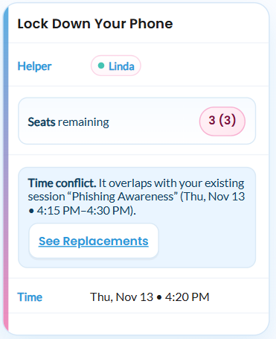
Table of Contents
16. Time Overlap
If a session overlaps with a participants session from My Sessions, the card will note that there is a time conflict to not double book the participant. Fortunately, they can See Replacements and atomically switch to another time of the same course if available.

Slide 28
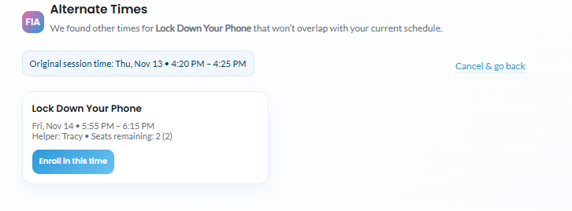
Table of Contents
17. Session Switch
Upon clicking See Replacements, the participant can enroll in a new time of the same session on this screen. Optionally, they can cancel and go back if they don’t like any of the times shown.

Slide 29
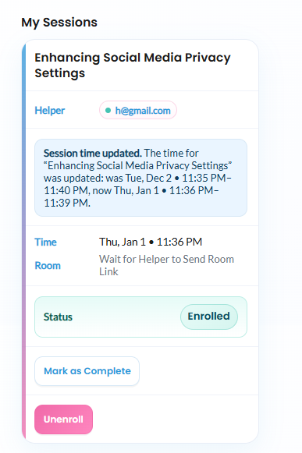
Table of Contents
18. Session Edit
If an admin edits a session, the participant will see a notification on their session card. If their is a time overlap with an existing session of theirs, the participant can use the See Alternatives button (seen on the past slides) to reschedule and fix the time overlap. Admins should try their best to not create conflicts though.

Slide 30
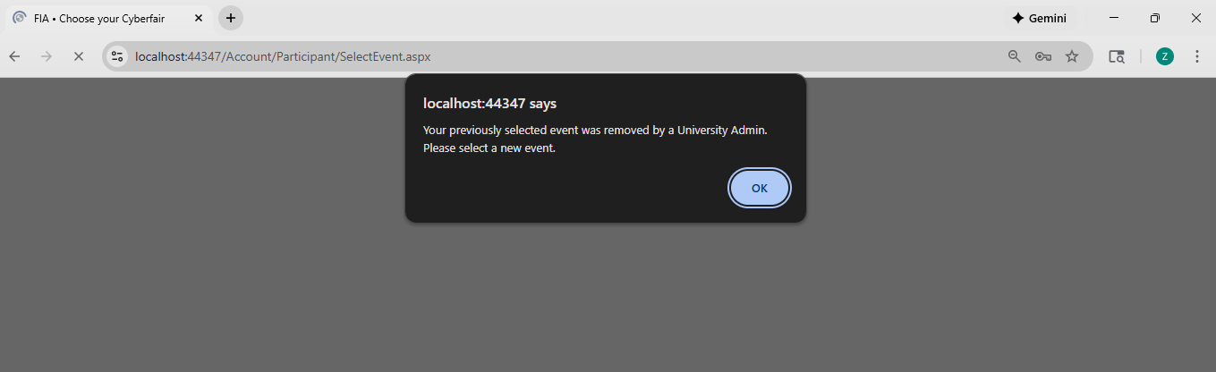
Table of Contents
19. Session Delete
If an admin deletes a session that a participant is scoped into, it will display a notification on their home view that the event has been deleted.

Slide 31
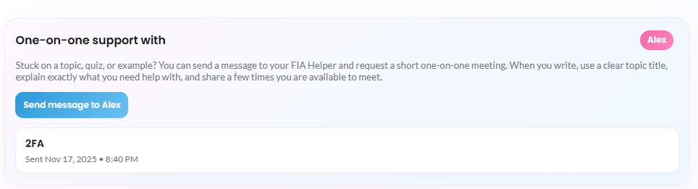
Table of Contents
20. Request Help
Participants are all assigned one helper from their university. In this section, participants can send messages to their helper (and see previous message chains).

Slide 32
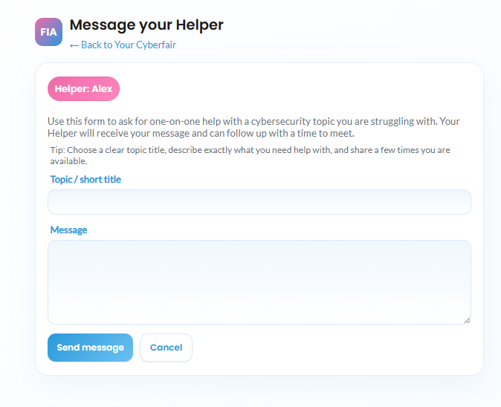
Table of Contents
21. Helper Chat
Participants can choose a message topic and send a message body where they should indicate what they need help with and time availability for a potential one on one Zoom meeting.

Slide 33
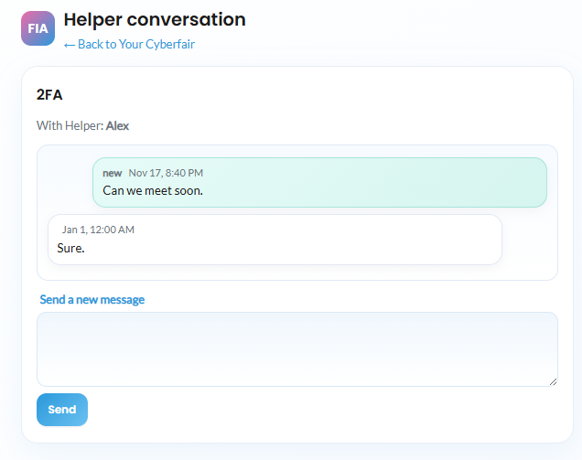
Table of Contents
22. Message Chain
Participants can view their whole chat log and send messages after their initial message to get the help they need.

Slide 34
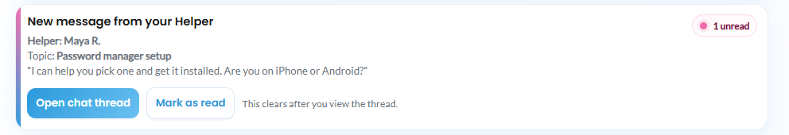
Table of Contents
23. Message Notification
Participants can receive alerts when they they receive a message from their helper, and have the option to open the chat thread or mark as read.

Slide 35
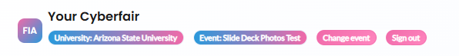
Table of Contents
24. Top Panel
In addition to everything else, at the top of the event screen, you can see your current university and event. In addition, you can change event with the Change Event button which takes you back to the original selection screen or you can even Sign Out as well to log out of your account and be brought back to the home screen.

Slide 36
Helper
Screens

Slide 37
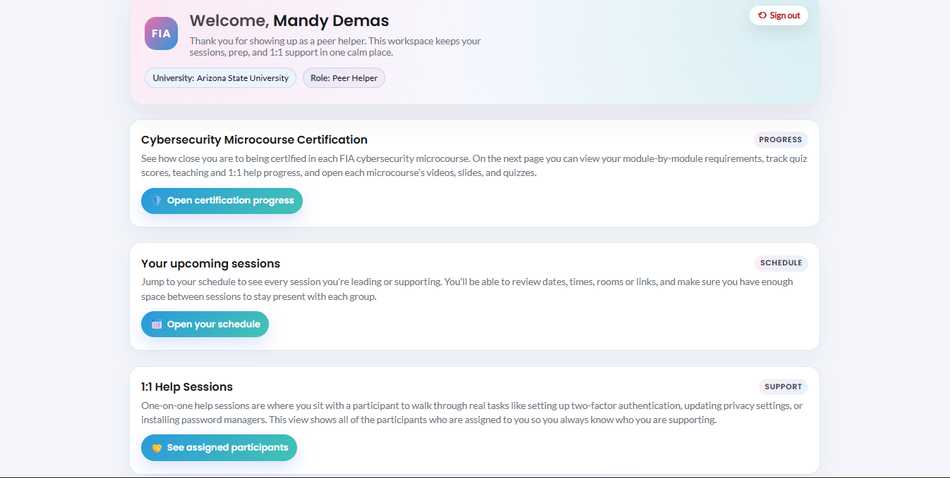
Table of Contents
1. Helper Screen
This is the main screen for helpers once they log in. It allows helpers to access certification and course information, upcoming micro course session, and one on one help sessions with their assigned participants.

Slide 38
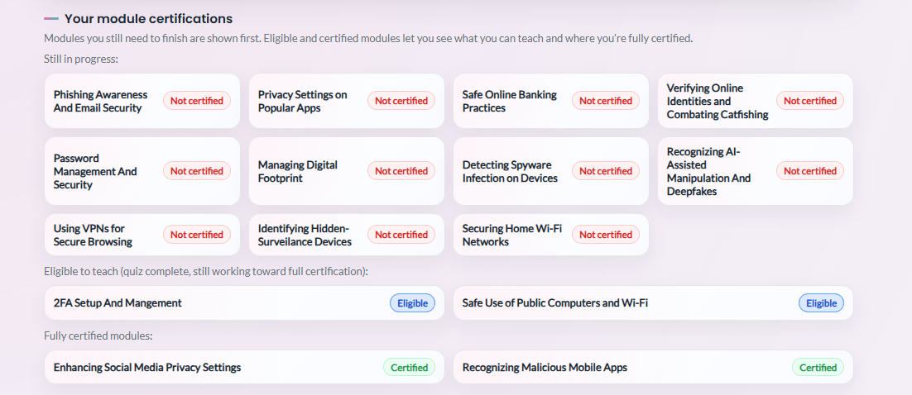
Table of Contents
2. Certifications
The Certification screen from the home view allows helpers to see their eligibility/helper status for each microcourse. For reference, helpers become eligible to teach once they read the Google Classroom materials and pass the corresponding quiz(zes). They then become certified when they deliver sessions for the course and/or deliver one on one session help with their assigned participants (rules created by Super Admin).

Slide 39
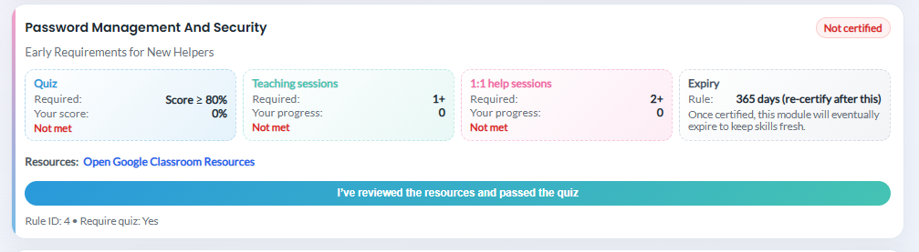
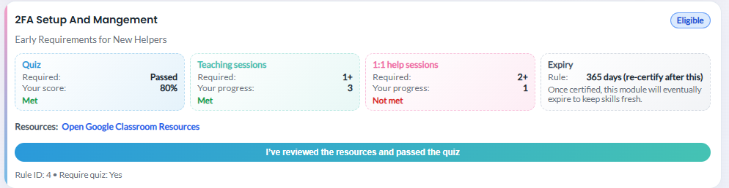
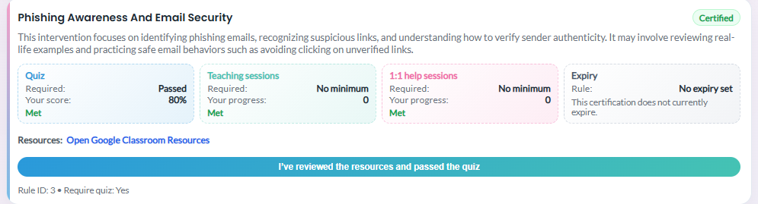
Table of Contents
3. Course Info
If the helper scrolls down on the certification page, they can see their progress towards all current microcourses (quiz score, teaching sessions, and 1:1 help sessions, and an optional expiry date for the cert). They can access course materials with the link provided and can mark completion of the quiz here (the schedule and 1:1 screen then allow the helper to update the other fields → teaching or 1:1 sessions).

Slide 40
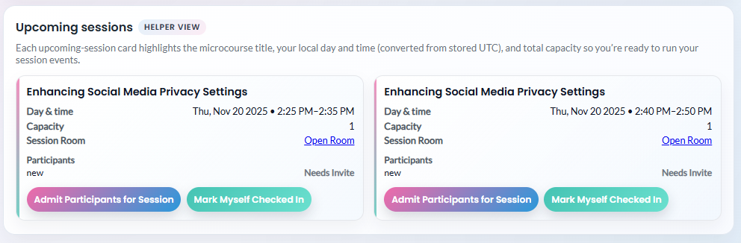
Table of Contents
4. Session Info
Upon clicking on the Sessions section of the helper home screen, they are taken to a screen where they can see their assigned sessions. It shows the date/time of the session, the room link, and the current participants signed up (and if they have received an invite yet). Click the Admit Participants for Session button to send the room link on the participant view.

Slide 41
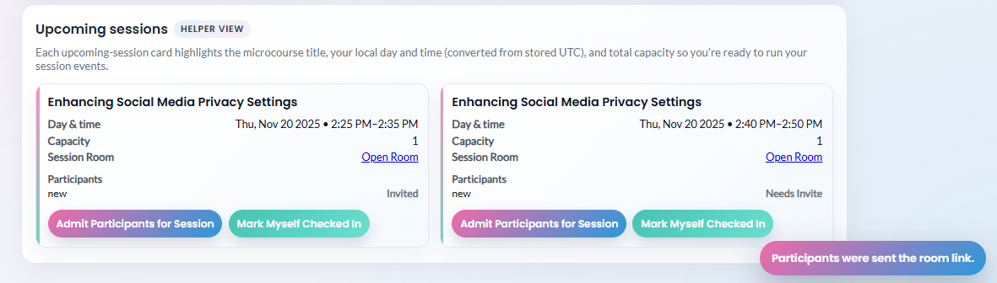
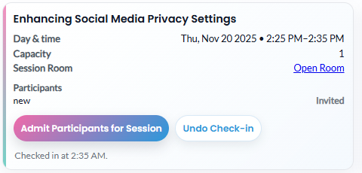
Table of Contents
5. Admit / Check In
This screen shows the confirmation upon admitting participants and also shows how the participant section updates to show an invite was sent. Participants can now join the room. Upon sending the invite and opening the room link, the helper can then mark themselves as checked in. Upon checking into the session, helpers have a brief time-window where they can undo the check in (e.g., they didn’t mean to click the button).

Slide 42
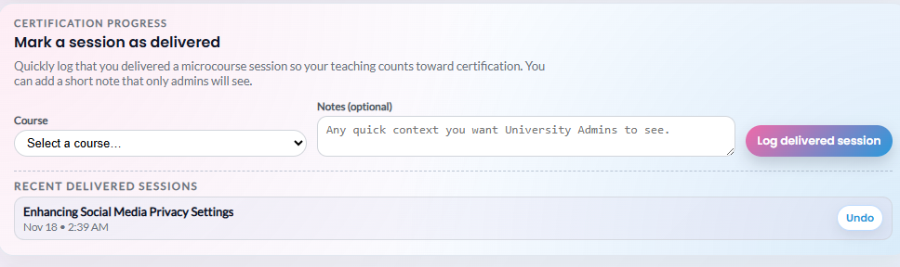
Table of Contents
6. Mark Delivered
Above where the helper can see their assigned sessions, they can also mark a session as delivered (and optionally, leave a short note for admins to see) which will count towards certification progress. It will also display previously delivered sessions and allow for an undo if a mistake is made.

Slide 43
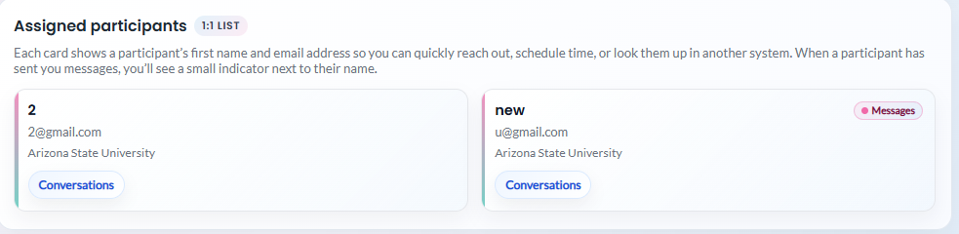
Table of Contents
7. 1:1 Sessions
When the helper clicks on the 1:1 sessions section from their home screen, they can see all current participants from their university assigned to them. For each participant, they will see an indicator if the participant has sent a message requesting help. They can click on Conversations to view conversation chains and give them the help they need.

Slide 44
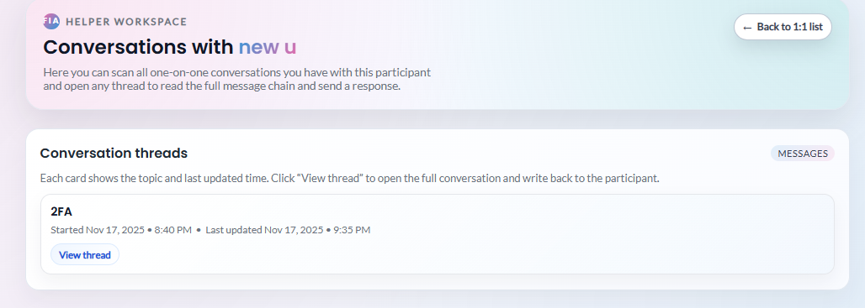
Table of Contents
8. Conversations
Upon clicking Conversations, they can see all threads with the current participant. They can click into specific conversations to see the entire message chain.

Slide 45
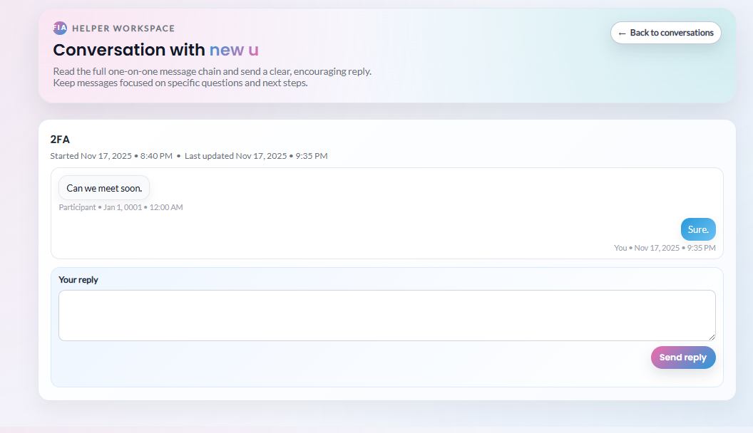
Table of Contents
9. User Chat
When clicking into a specific conversation thread, helpers can see the entire message chain where they can provide help or set up a time to meet with the participant to provide the help they need. The messages shown on the right are a super simplified version of this just to show functionality and design.

Slide 46
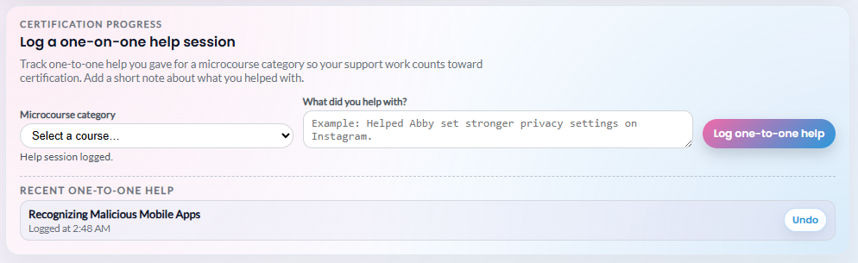
Table of Contents
10. Record Help
After helping a participant one on one, helpers can record a log of what microcourse they helped with and allows them to list how exactly they helped (which will be used for certification tracking progress). The system also allows for undos of previous help sessions if a mistake was made.

Slide 47
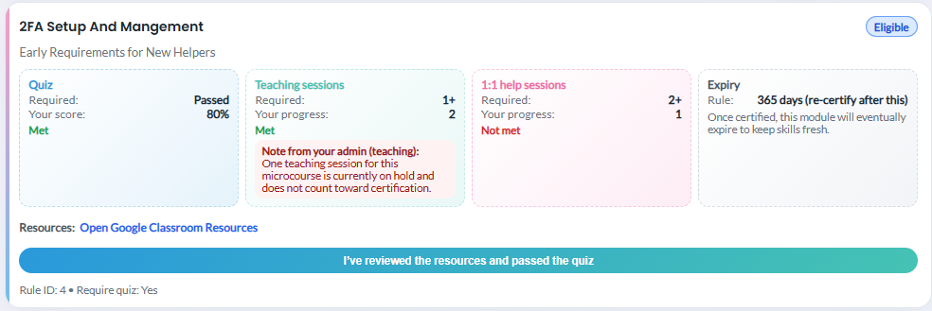
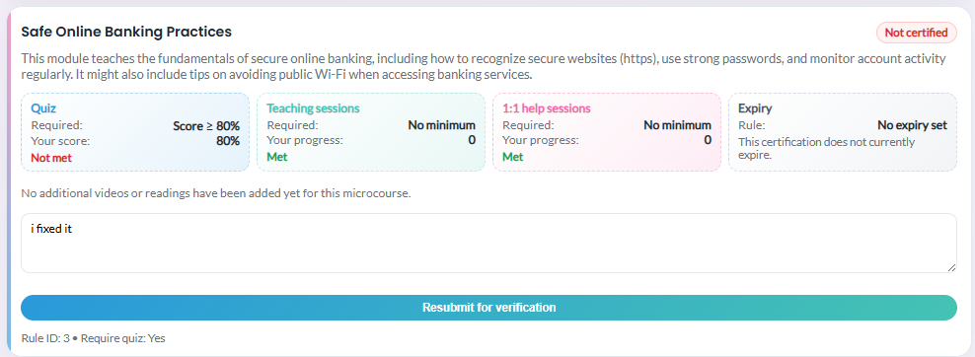
Table of Contents
11. Admin Check
If an admin questions any logs from the helper regarding their certification, the statuses will appear here on their certification page. It will allow for the helper to resubmit for verification and send a message back to the admin for re-review.

Slide 48

Table of Contents
12. Admin Check Cont.
Additionally, if a log is set as verified by the admin, the helper will see a verification status next to the microcourse card.

Slide 49
Admin Screens

Slide 50

The following screens will detail workflows for Super Admins

Slide 51



Table of Contents
Super Admin
Add cert rules and prereqs
Edit title, summary, etc.,
1. Micro Courses
As the super admin, you have the ability to add in new micro courses that university admins can choose to include in their cyberfair events. The home page presents you with a form to add a new one with a title, duration, summary, external links, a status (use publish to make visible or draft to hide for now), any certification metrics needed for helpers to be able to teach the micro course, and prerequisite microcourses. Save when done!
Save when completed to add to catalog

Slide 52

Table of Contents
Super Admin
2. Find Rules
As the super admin, you also have the ability to add certification rules for micro courses. Find the edit page in the Certification Rules section right under where you add micro courses. Add new rules by clicking “Open Certification Rules.”

Slide 53

Table of Contents
Super Admin
3. Edit Certification
On this page, Super Admins can add in certification rules that peer helpers will need to complete before being certified to teach a micro course session in a cyber fair event. You can set a passing quiz score percentage, specify aspects line minimum sessions taught, and add prerequisite rules.
Use the “Edit” button to change an existing rule. It will automatically fill in the form fields on the left and allow you to make/save/delete any changes you want.

Slide 54

Table of Contents
Super Admin
4. Find Editing
To edit microcourses, Super Admins can edit their existing microcourses they made previously by locating this card on the right nav bar. Open microcourse manager to begin editing.

Slide 55



Table of Contents
Super Admin
5. Edit Microcourse
To edit microcourses, press the Edit button next to any existing microcourse. This will open a field at the bottom of the screen to edit all microcourse information. After you are satisfied with the changes, save the microcourse updates with Save changes. Use Clear selection to clear the bottom screen once you are done editing. Use Delete microcourse to remove the microcourse from the catalog.

Slide 56


Table of Contents
Super Admin
6. Add Unv Admin
Super admins can create a new University Admin in the system from the Create University Admin page. You can specify the name, email, their university, and password. If you specify a new university, it will add a new university to the system.

Slide 57


Table of Contents
Super Admin
7. Audit Log
Super Admins can view a system wide activity log of the system which includes logs from sign in, helper activity, participant activity, etc. To get here, use the Open audit log button on the home view. These results can be filtered with a search, by role, by log type, by university, and by timestamp to see the appropriate logs. Filters can be cleared at any time. Additionally, the logs can be exported to CSV with the Export CSV button.

Slide 58

Table of Contents
Super Admin
8. Export CSV
This is what the export to CSV looks like. It is a clean Excel sheet of all the logs. To make the view cleaner, expand the size of each column (locate where it says A B C D at the top and drag each one to be bigger so all information can be displayed cleaner and not overlapped).

Slide 59

Table of Contents
Super Admin
9. Critical Logs
For critical logs, Super Admins have a clean place to view them. This log is found right below the normal audit log seen on the slide before this one. These critical logs include events like repeated failed password attempts for admin accounts. They can be filtered and exported to CSV just like the normal audit log.
Logging Schema Info can be found here: FIA_Audit_Logging_Standard.docx

Slide 60

Table of Contents
Super Admin
10. Critical Alert
When a critical log appears in the critical log, an alert will appear on the Super Admin home. These will disappear when the critical log is viewed by the admin.

Slide 61
The following screens will detail workflows for University Admins

Slide 62

Table of Contents
University Admin
Create Cyberfair
This is the home page for university admins. The first thing you can do is create cyberfair events for your university that will host micro course sessions taught by peer helpers. To add a new cyberfair event, use the following form to fill in event info then save the event. This will make the event visible to peer helpers and participants.

Slide 63

Table of Contents
University Admin
2. Manage Cyberfair
Beneath the form for creating a cyberfair event, you can also manage upcoming and active events. Click on the “Manage” hyperlink for whichever event you want to view to be sent to the management page.

Slide 64

Table of Contents
University Admin
3. Manage Cyberfair
(Continued)
The first form of the event management page allows you to adjust Event information like the Event Name and Description. It also allows you to delete the event if you don’t want the event to appear in the catalog anymore.

Slide 65

Table of Contents
University Admin
4. Manage Cyberfair
(Continued)
The second form of the event management section allows you to select which microcourses will appear for participants and helpers in their views.

Slide 66


Table of Contents
University Admin
5. Manage Cyberfair
(Continued)
Beneath where you select micro course visibility, you can add in sessions for your event where peer helpers will teach the micro courses you added to your event. Use the course dropdown box to select the appropriate micro course, then schedule the session start/end times, assign a peer helper, and optionally add a room link or max amount of participants. You can also view a list of the current sessions in the “Scheduled Sessions” section to ensure you don’t double book a helper.
IMPORTANT NOTE:
If a new session’s start/end time overlap with an existing session, you get this message. Choose a different time!

Slide 67

Table of Contents
University Admin
6. Helper Selection
For selecting a helper, the admin can see all current helpers for the university and can filter by Eligible only, Certified only, or by something like helpers with the most teaching sessions for the course. All Eligible and Certified helpers will be displayed by default and you will see their availability status based on the current time selected. It may be a good idea to have a good mix of Eligible helpers (need teaching sessions to become certified) and Certified helpers (proven to give good sessions with their past history of teaching the course).
System will note if a time overlap exists so no helper is overbooked!

Slide 68


Table of Contents
University Admin
7. Edit Session
At the very bottom of the event management screen, there is an option to edit all current sessions for the event. Select Edit to bring up the form for editing that specific session. This will bring up the same forms for editing the session that you filled out previously. Helper availability is also shown and if you select a new time that conflicts with a helper’s already assigned session, it will display a Time Conflict message next to their name.
Overlap Indicator

Slide 69

Table of Contents
University Admin
8. Impact Summary
In addition to seeing how helpers are impacted in the session editing screen, there is a summary of all enrolled (and waitlisted) participants and if there will be a time conflict with their existing sessions if the timestamp of the session is edited by the admin. Try not to cause too many time conflicts but in the worse case scenario, participants have the See Alternatives options on their pages in case of conflicts.
Important: Sessions can also be deleted at the bottom
of this session editing form.

Slide 70


Table of Contents
University Admin
9. Add Helper
University Admins can access a form to add new helpers on their home screen as well. This form allows them to add their email, name, and a password for signing in (can be changed later – we will add this functionality in a future sprint). This will add the helper to their university where they can be assigned to sessions, help participants, etc.,

Slide 71


Table of Contents
University Admin
10. Audit Log
The first part of the audit log screen is a section to view helper actions. It displays all current helpers in the system where you can view their actions and approve or question (counts towards their certification progress).

Slide 72

Table of Contents
University Admin
11. Helper Log
In the helper log, the top sections shows their certification verification for quizzes they took for each microcourse. For each time the helper marks they read the materials and completed a quiz, it will pop up an alert here to which the admin can mark as verified or question. If verified, the helper gets a verified mark on their screen next to the microcourse. If questioned, it takes away from their certification progress until the helper resubmits (to which the admin can review again and see additional notes for the re-review). View the helper screens for more details on what this looks like from their POV.

Slide 73

Table of Contents
University Admin
12. Helper Log Cont.
University Admins can also view the helpers progress on their teaching and 1:1 sessions with participants. These can be verified and questioned in the exact same way. Helpers can resubmit for re-review but when questioned, it will subtract from the helper’s teaching sessions or 1:1 sessions until fixed.

Slide 74

Table of Contents
University Admin
13. Helper Log Cont.
At the very bottom of the helper log screen, you can see the logs for this specific helper to help verify their activity (also cross-reference with Google Classroom and Zoom activity to ensure you are making the right decision). These logs can be filited and exported to CSV optionally.

Slide 75

Table of Contents
University Admin
14. Unv Audit Log
Finally, in addition to just seeing specific helper logs and certification progress, the bottom of the audit log screen shows a total activity view of the entire university. These can be filtered and exported to CSV optionally to find the appropriate logs as needed.
For reference, here is the logging schema (ignore critical logs as those are for the Super Admin):
FIA_Audit_Logging_Standard.docx

